Slide 1


Hotel Booking Management System
IGATE is now a part of Capgemini

Slide 2
TEAM MEMBERS
Kartik Kumar Singh (TL)
Himanshu Kataria
Harshita Ahuja
Ijas Ahamed

Slide 3
CONTENTS
OVERVIEW
ACTORS
TESTCASE
REQUIREMENT ITEMIZATION
USECASE
DEFECTS
APPLICATION LINK
TEST CASE ADEQUACY
TEST CASE EFFECTIVENESS
PROJECT STATISTICS

Slide 4
OVERVIEW OF THE PROJECT
Hotel Booking Management System is an online website, developed to provide services for booking rooms in hotel across multiple cities.
First, User needs to register in the hotel website and during Login time they have to select their role.
In which, Admin can add/update or delete the details of the hotel.
Employee and customer can book, search, view the details of hotel

Slide 5
ACTORS
Admin
Customer
Employee

Slide 6
TEST CASES
A test case is a set of conditions or variables under which a tester will determine whether a system under test satisfies requirements or works correctly.
The process of developing test cases can also help find problems in the requirements or design of an application.

Slide 7
Link : HBMS TEST cASE
TEST CASES
LOGIN
HBMS
Employee
Customer
HBMS
Admin

Slide 8
Link : HBMS TEST cASE
TEST CASES
Registration
HBMS
Customer
Employee

Slide 9
REQUIREMENT ITEMIZATION
Requirements validation is an iterative process which takes place throughout the lifecycle of the project.
During elicitation, analysis and specification you should constantly be questioning and clarifying the data given to you in order to check its validity.
This will ensure that the SRS that you produce is complete, consistent and ready for the formal validation process.
LINK: HBMS RVFD

Slide 10
Requirements Validation And Functional Decomposition
Termination
End process
File Handling
Storage of information
Invocation
Start process
Implicit
Efficiency
RVFD
System
Minimum specifications
Explicit
User specified
Query
improvements
Error Handling
consistency
Security
For confidentiality

Slide 11
USE CASES
A use case is a methodology used in system analysis to identify, clarify, and organize system requirements.
The use case is made up of a set of possible sequences of interactions between systems and users in a particular environment and related to a particular goal.
A use case can be thought of as a collection of possible scenarios related to a particular goal, indeed, the use case and goal are sometimes considered to be synonymous.

Slide 12
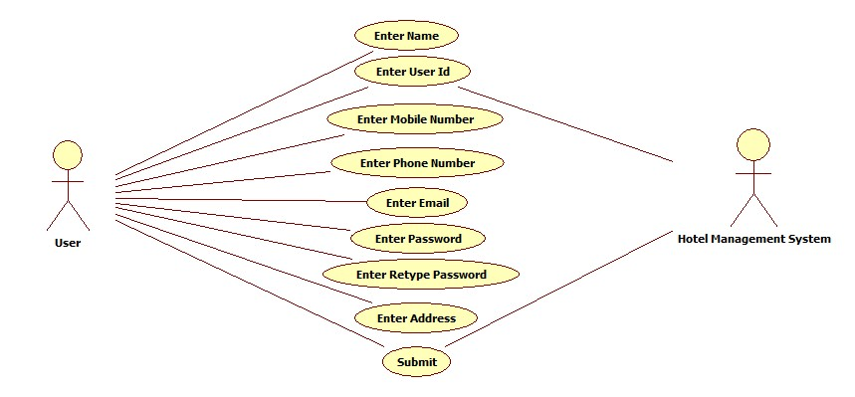
USE CASES
Registration Use Case Diagram

Slide 13
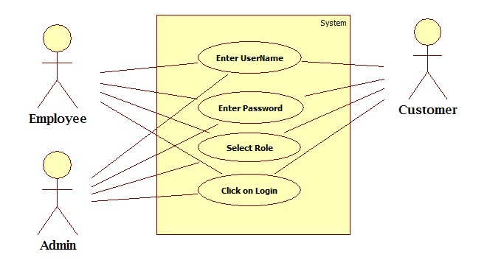
USE CASE DIAGRAM
Login Use case Diagram

Slide 14
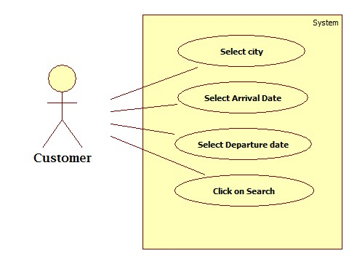
USE CASE DIAGRAM
Hotel/Room Search Use Case Diagram

Slide 15
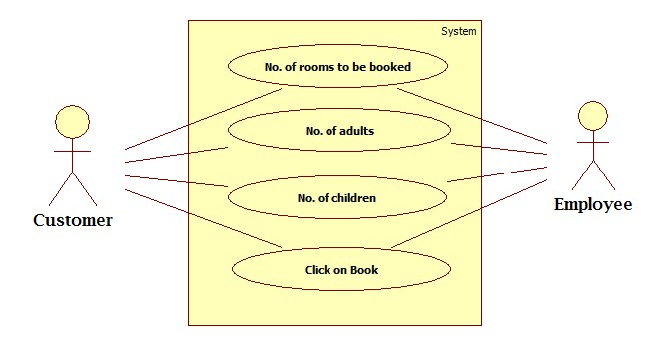
USE CASE DIAGRAM
Hotel Room Book Use case Diagram

Slide 16
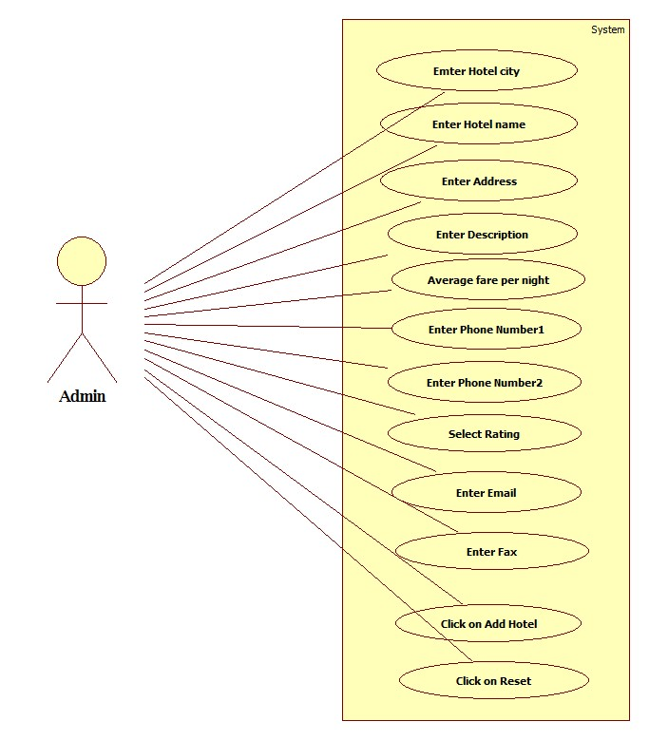
USE CASE DIAGRAM
Add Hotel Use case Diagram

Slide 17

USE CASE DIAGRAM
Update Hotel Use case Diagram

Slide 18
USE CASE HYPERLINKS
Registration
HBMS Registration
Login:
HBMS Login
Add Hotel
HBMS Add Hotel
Update Hotel
HBMS Update Hotel
Book Hotel
HBMS Booking
Search Hotel
HBMS Search

Slide 19
DFDR
A defect is an error or a bug, in the application that causes it to produce an incorrect or unexpected results.
A programmer while designing and building the software can make mistake or error.
These mistakes or errors mean that there are flaws in the software, these are called defects and the report written for logging these defects is called a defect report.
LINK: HBMS Defect

Slide 20
DEFECTS FOUND
The Username field in the Login page is found to accept numbers and special characters.
The Password field in the Login page is unable to accept numbers and special characters .
The Login button in the Login page is unable to verify for the existence of username in the database .
The Login button in the Login page is unable to verify for the matching of password with the username entered by the user.
The Signup link in the Login page is unable to display the signup\register page for signing up new user.

Slide 21
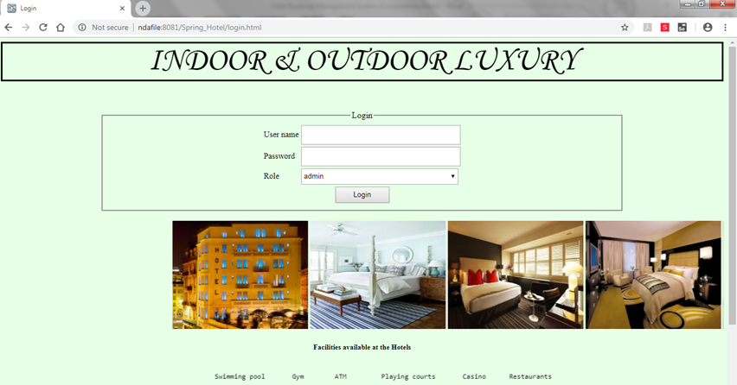
Application link
http://ndafile:8081/Spring_Hotel/login.html

Slide 22
Test Case Adequacy
This defines the number of actual test cases created vs estimated test cases at the end of test case preparation phase. It is calculated as
Test Case Adequacy = No. of actual Test cases*100/No. of estimated Test cases estimated
=(159*100)/200
=79.5

Slide 23
Test Case Effectiveness
This metrics defines the effectiveness of the test cases which is measured in terms of the number of defects found in testing with using the test cases.
Test Case Effectiveness = No. of defects detected using test cases*100)/total no of defects detected in testing
=(53*100)/70
=75.71

Slide 24
Project Statistics
Number of Test Cases = 143
Number of Test Cases Passed = 73
Number of Test Cases Failed = 70
Number of Defects Logged = 70
Number of Use Cases = 6

Slide 25
THANK YOU

